Slide 1
Linear Regression
By Dr. Ali Saeed

Slide 2
Linear Regression
In linear regression (relationship in dependent and independent is linear in nature)
Independent Variable
  Input from the real world
Dependent Variable
  It is continuous in nature
X is independent and Y is dependent variable
In linear regression, as the value of X will rise the value of Y will also rise

Slide 3

Linear Regression
Simple linear regression in which one independent variable and dependent variable. As shown in the following equation:
Multiple linear regression in which multiple independent variable and one dependent variable. Here “a’s” are coefficient:
Coefficients represent “importance” of attribute.

Slide 4
Linear Regression
More coefficient value represent more importance of that particular attribute.
That independent variable is more important
Example:
0.2(Matric) + 0.5 (FSc.) + 0.1(5 class-standard)
When we provide “training set” to ML Algo it will understand “a’s” value

Slide 5
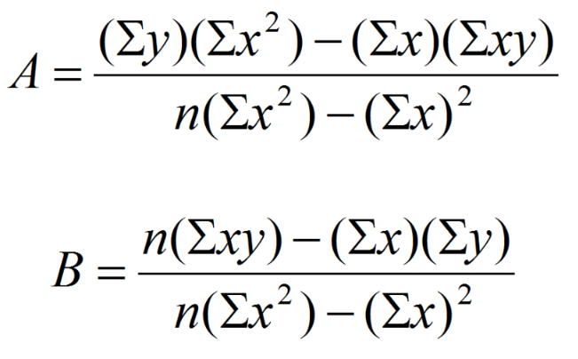
Formula to compute A and B
Y = B (X ) + A

Slide 6
Example with answer
X | Y | XY | X²
1 | 3 | 3 | 1
2 | 4 | 8 | 4
3 | 5 | 15 | 9
4 | 7 | 28 | 16
10 | 19 | 54 | 30
Answer
A= 1.5
B= 1.3
Y= B (X) + A

Slide 7
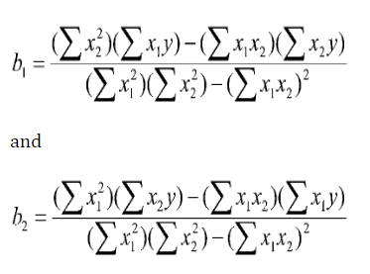

Linear Regression with 2 independent variables
Y = a + b1 X1 + b2 X2

Slide 8
Example
X1 | X2 | Y
2 | 13 | 12
5 | 7 | 22
8 | 34 | 21
13 | 1 | 31
54 | 23 | 42

Slide 9
Thanks

